Slide 1
Ashburn, Equinix
VA, USA
London THN
Lisboa Equinix
ACE
Fortaleza
EQ. Guinea
SAIL Submarine System
º
Sao Paulo
Equinix SP2/3
ACE
Teraco CPT

Slide 2
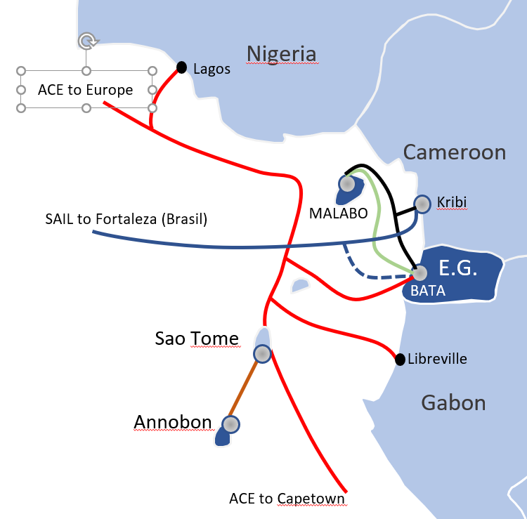

Slide 3
Lagos
Nigeria
ACE to Europe
Cameroon
SAIL to Fortaleza (Brasil)
MALABO
Kribi
E.G.
BATA
Sao Tome
Libreville
Annobon
Gabon
ACE to Capetown
Congo

